Slide 1
Short Text Similarity
Chatbot Query Similarity Prediction
Anurodh Raina
Shubendu Biswas

Slide 2
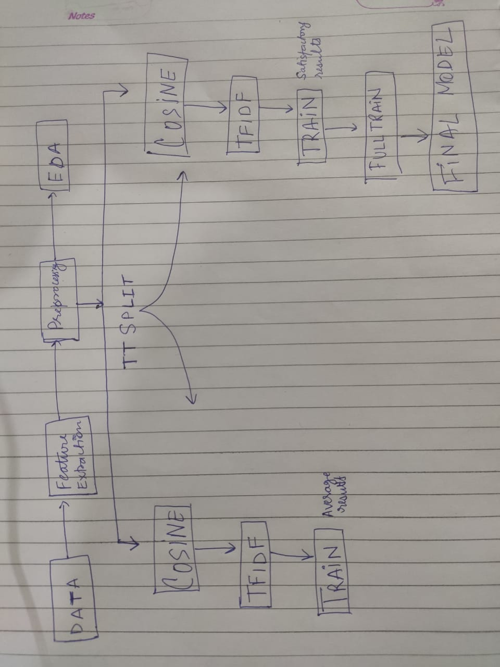
FLOW CHART!

Slide 3
Similarity prediction
WHAT --
Given pairs of sentences from all the different sorts of chatbots, predict if the given pairs are similar or not.
WHY --
Having the understanding of similarity in the queries gives a lot of business value. Similar queries can be routed to the same FAQ for faster resolution. Also lesser the number of conversation cycles in solving customer queries, greater is the satisfaction.

Slide 4
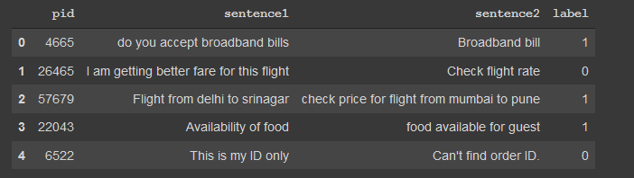
DATA
3 useful features

Slide 5
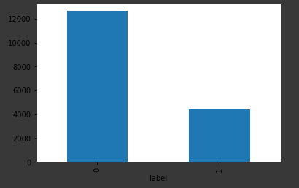

0 i.e. ‘not similar’ has
12650 data points
whereas,
1 i.e. ‘similar’ has only 4394
data points
There is a high imbalance present
in the data

Slide 6
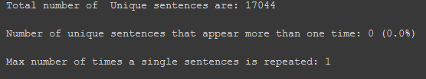
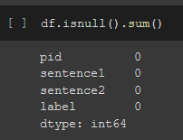

No repeated sentences
No null values
Sentences with only 1
word are present

Slide 7
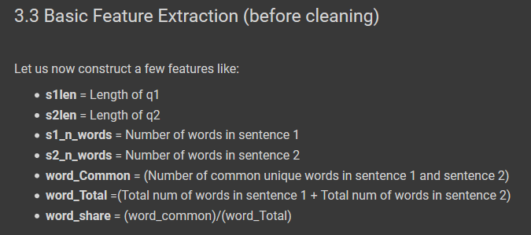
Based on the data we came up with some generic features that could assist our model in catching a pattern for the similarity prediction.

Slide 8
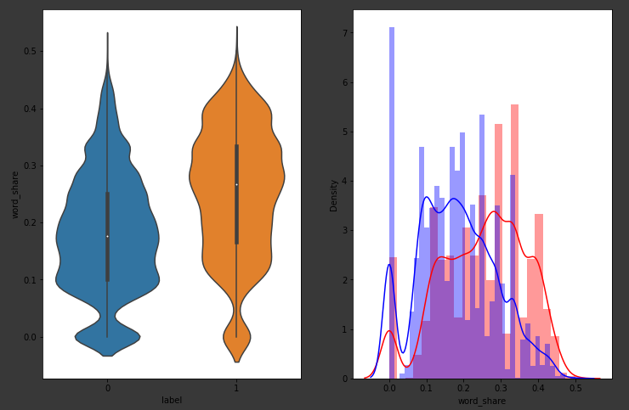
Analysing the extracted features
Feature – Word_share
The distributions for normalized word_share have some overlap i.e., there are quite a lot of sentences with high word similarity
The average word share and Common no. of words of sen1 and sen2 is more when they are duplicate(Similar)

Slide 9
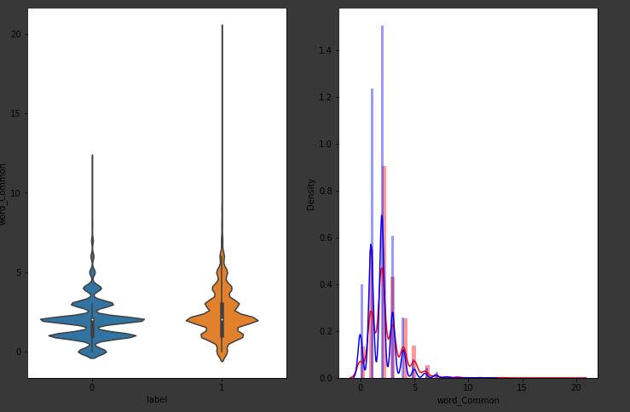
Feature – Word common
The distributions of the word_Common feature in similar and non-similar sentences are highly overlapping
So to conclude this, these features won’t really make a difference in the leaning process of the model.

Slide 10
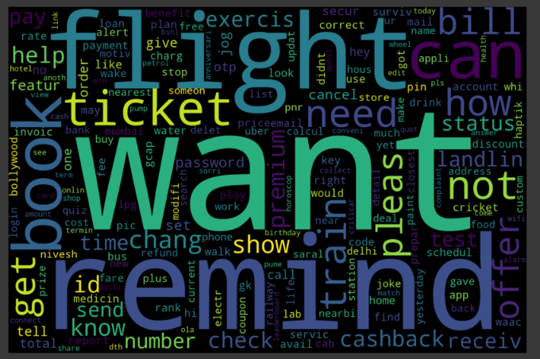
Word cloud

Slide 11
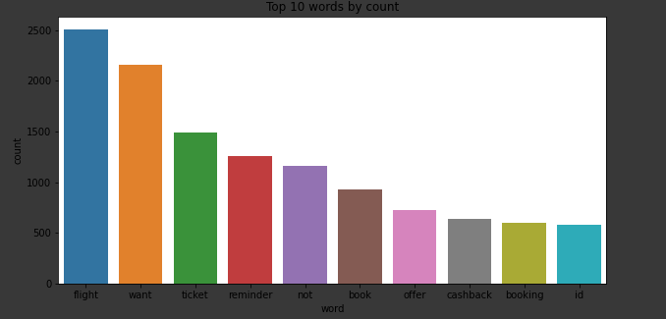
Top 10 words
used in the document

Slide 12
Preprocessing
Again, a variety of methods were tested:
Removing Punctuations
Performing stemming, lemmatization
Removing Stopwords
Expanding contractions etc.

Slide 13
We created a custom list of stopwords to process our data with
Kept words which are high in frequency and meaning.(not, never)
Replaced abbreviations with their full forms(ID, OTP, DTH)
We handled the contractions like (can’t, won’t, she’s, I’ve) manually, replacing them with their proper forms wherever it was necessary.
We also made another feature which contained the Cosine similarity of the two sentences.
We had to think of all the different ways 2 sentences could be similar.

Slide 14
Vectorizing
Experimenting wherever necessary, we used a tfidf vectorizer
with, n_grams= ( 1,2 )
min_df = ( 3 )
max_df = ( 1 )
max_features = ( 5000 )
After Vectorization (shape of data) :
Train sentence1- (13606, 5573) (13606,)
Train sentence 2- (13606, 5573) (13606,)
Test sentence1- (3402, 5573) (3402,)
Test sentence2- (3402, 5573) (3402,)

Slide 15
MODEL TESTING
Starting with a 2 vanilla models,
A logistic regression and a SVC classifier.
Both didn’t provide a satisfactory result even after tuning the logistic model.
A random Forest classifier did come close to achieving the best score, you can see the results on the next page.
Our best model however was a Xgboost with the following parameters: maxdepth = ( 15 )
n_estimators = ( 1000 )
scale_pos_weight = ( 0.5)

Slide 16
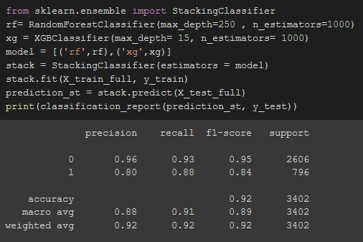
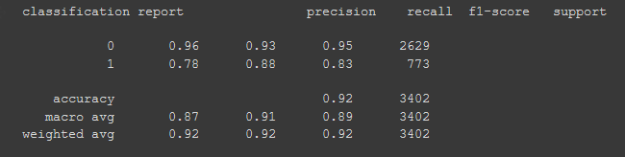
SCORES
STACKING CLASSIFIER
XGBOOST MODEL

Slide 17
If we had more time
-- A different way to pre-process the data
-- A more in depth analysis.
-- Using different approaches with our models.

Slide 18

Any questions?

